Slide 1
HEAPS
Ioana, Jordan, Ava, Jemima

Slide 2
Concepts/Vocabulary relating to HEAPS
NODES | individual elements of tree contains data and 0 or more links to other nodes
ROOT | topmost node in hierarchy (either lowest or higher value)
CHILD NODE | node that is subordinate to another node
TREE | hierarchy definition of a tree is recursive can contain no nodes has subtrees

Slide 3
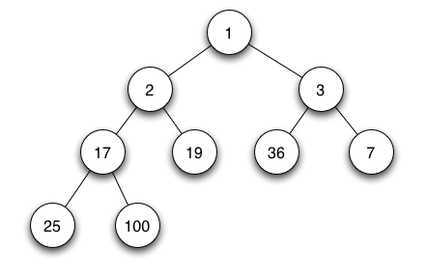
What is a HEAP?

Slide 4
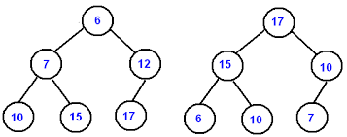
Classifications of HEAPS
MIN HEAP
MAX HEAP

Slide 5
Adding and removing elements
to and from a heap

Slide 6
Adding and removing elements to and from a heap
UPHEAP
add node to heap
when you upheap a node:
compare value to its parent node, switches two nodes accordingly
DOWNHEAP
compares node with its 2 children
if node > 1 or both children, switches place with child of lowest value
ensures new parent node is lowest of the three nodes
Most of time taken by algorithm is spent upheaping and downheaping.

Slide 7
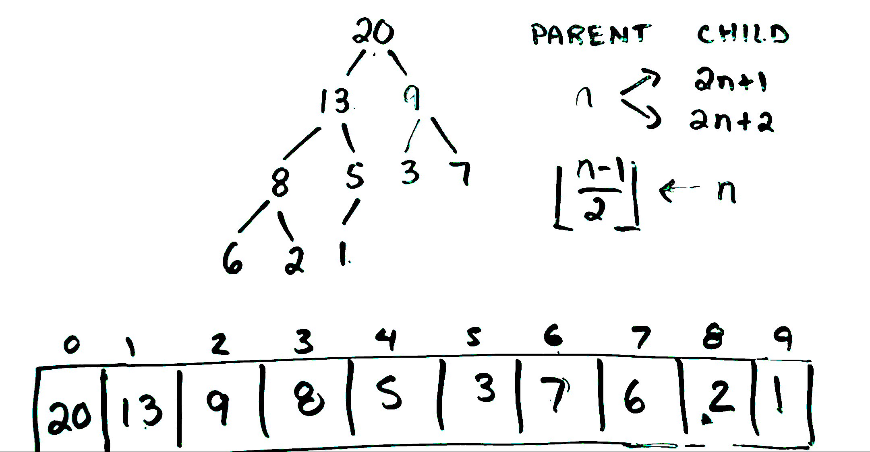
How do you translate a heap into an array?
Describes relationship between parent-child in terms of index number (n) in array
TREE
ARRAY

Slide 8
Pros & Cons of HEAPS
PROS | CONS
Easy to find min/max value Relatively easy to order HEAP SORT complexity is consistent in most cases O(n log n) | Not completely sorted QUICK SORT relatively faster than best case of HEAP SORT However: Worst Case of QUICKSORT: O(n²)

Slide 9
What other operations can you perform on a heap?

Slide 10
HEAP Sort
Comparison-based sorting algorithm
improved selection sort
Divides input into sorted and unsorted
Takes the largest element from the unsorted and moves it to the sorted elements
IMPROVEMENT:
uses the heap data structure rather than a linear-time search to find the maximum
Not a very stable sort
Complexity O(n log n)

Slide 11
Where/When you would use a HEAP
Use for quick access to largest/smallest item
will always be first element in array / root of tree
However, remainder is kept partially unsorted
Insertions are fast
OTHER SCENARIOS:
Games: Leaderboards
Winning player is always placed at top of charts
Event Scheduling
Earliest or event with highest priority is easily accessible (always at root of tree)

Slide 12
DEMONSTRATION

Slide 13
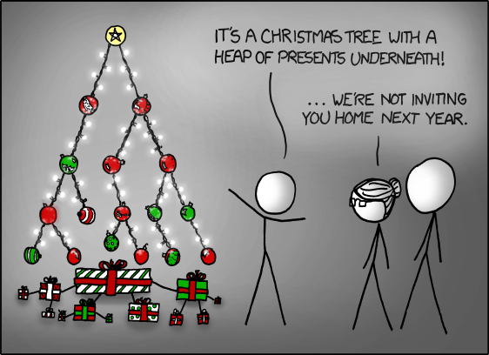
QUESTION OF THE DAY: ‘TIS THE SEASON
What is wrong with this heap structure?

Slide 14
SUMMARY
Tree-based structure → follows a hierarchy
Satisfies heap property:
Parent nodes have consistent relationship with its child nodes throughout
2 types
MAX heap → Parent > Child
MIN heap → Parent < Child
Heaps can be translated into arrays
Heaps allow for quick access to smallest / largest item in array

Slide 15
REFERENCES
http://gribblelab.org/CBootcamp/7_Memory_Stack_vs_Heap.html#sec-3
ttp://codereview.stackexchange.com/questions/32606/implementation-of-heap-sort
http://www.sanfoundry.com/java-program-implement-max-heap/
https://www.youtube.com/watch?v=c1TpLRyQJ4w
https://www.youtube.com/watch?v=ijfPvX2qYOQ
https://www.youtube.com/watch?v=fJORlbOGm9Y
https://en.wikipedia.org/wiki/Heap_(data_structure)

